Slide 1
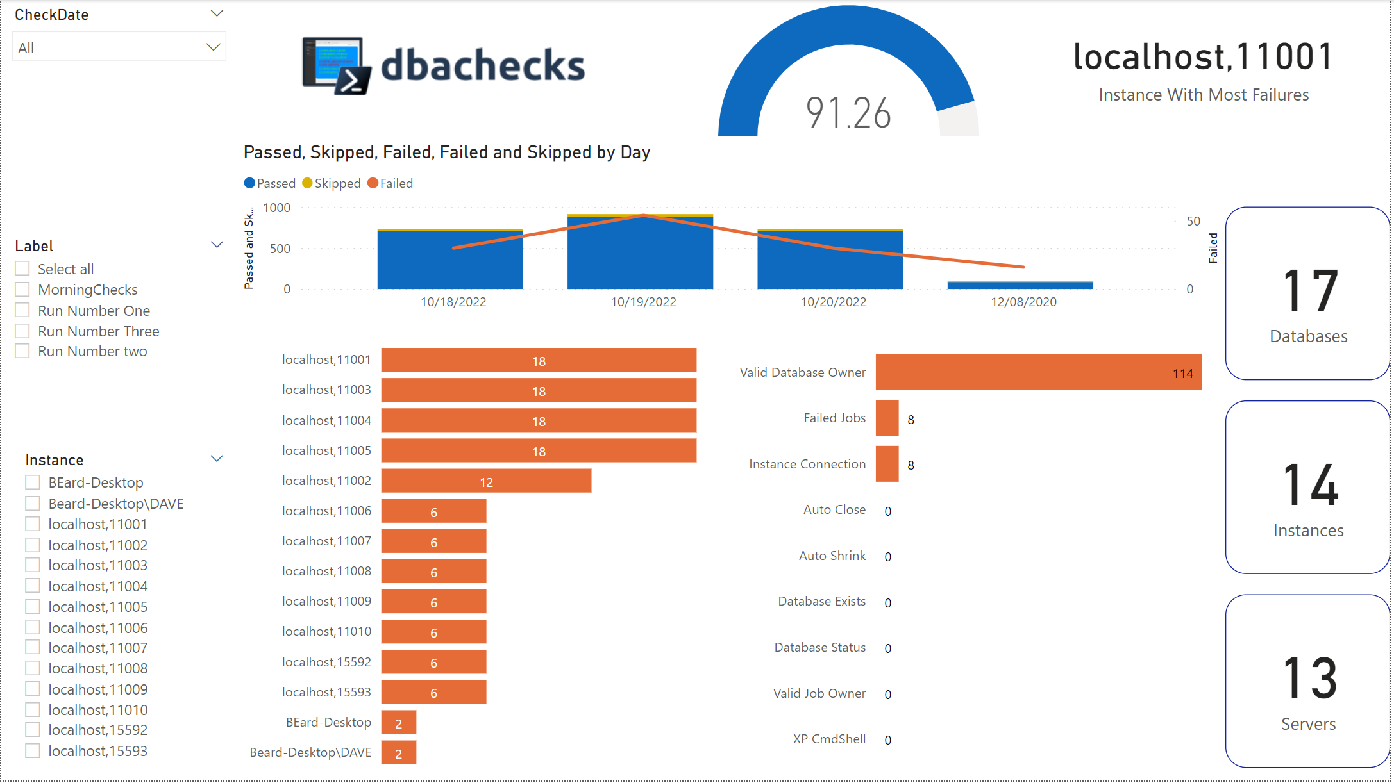
Introducing dbachecks v3
Introduction to latest version of dbachecks, a SQL Server configuration validation framework

Slide 2



Introduction
Who we are
What dbachecks is
Why it matters
DBAs and infrastructure experts supporting the SQL Server community
An open-source PowerShell module of validation checks for SQL Server environments
Helps DBAs and infra experts validate and secure SQL Server environments
dbachecks is an invaluable open-source tool created by and for the SQL Server community to validate and secure database environments.

Slide 3


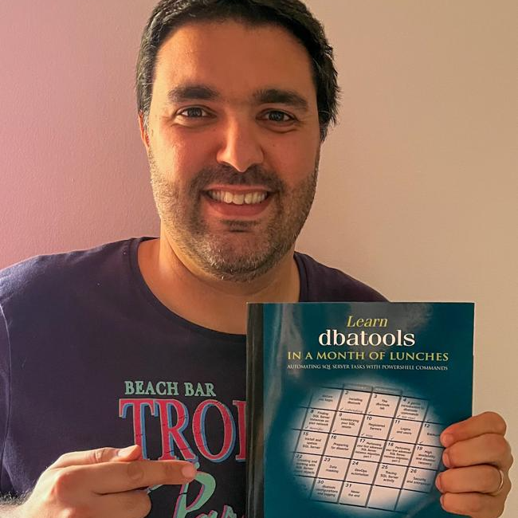
Who Did It?
Rob Sewell
Jess Pomfret
Claudio Silva

Slide 4



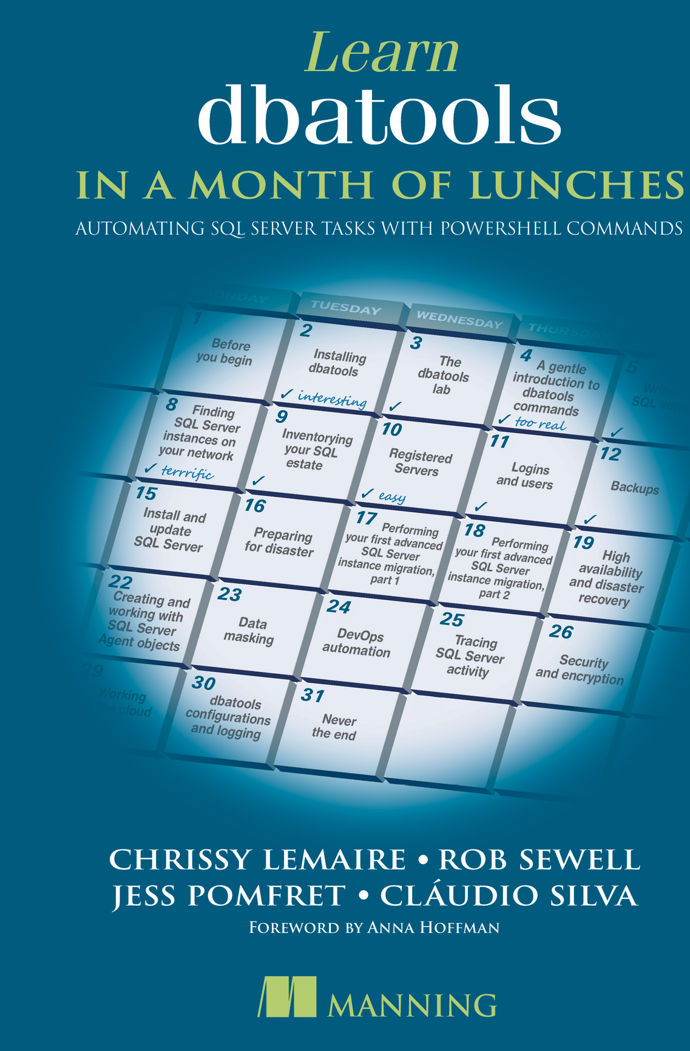


jpomfret7@gmail.com
Jess Pomfret
She/Her
I'm a data platform engineer with a passion for automation, proper football, and fitness. I enjoy contributing to open-source software and I'm a maintainer for dbatools.
DATA MASTERMINDS
Data Platform Engineer
DUAL MICROSOFT MVP
Cloud and Data Center Management
Data Platform
JESSPOMFRET.COM

Slide 5



claudiosil100@gmail.com
Cláudio Silva
He/Him
I work as Data Platform Engineer doing a lot of query performance tuning and I'm a PowerShell lover who automates any process that needs to be done more than a couple of times
DATA MASTERMINDS
Data Platform Engineer
MICROSOFT MVP
Data Platform
CLAUDIOESSILVA.EU

Slide 6



Rob Sewell
mrrobsewell@outlook.com
He/Him
I was a SQL Server DBA with a passion for Powershell, Azure, Automation, and SQL (PaaS geddit?) (And a sense of humour (and a habit for writing inside braces)). Now I just help other people with those (not the braces bit).
SEWELLS CONSULTING LTD
Beard Twizzler
DUAL MICROSOFT MVP
Data Platform
Cloud and Data Center Management
robsewell.com

Slide 7

What Is dbachecks?
dbachecks is an open source PowerShell module for
validating the configuration of SQL Server instances using Pester.
Notes:
"validating" appears twice

Slide 8

Evolution of dbachecks
2016
Initially, Rob created dbareports to validate and report on SQL estates

Slide 9
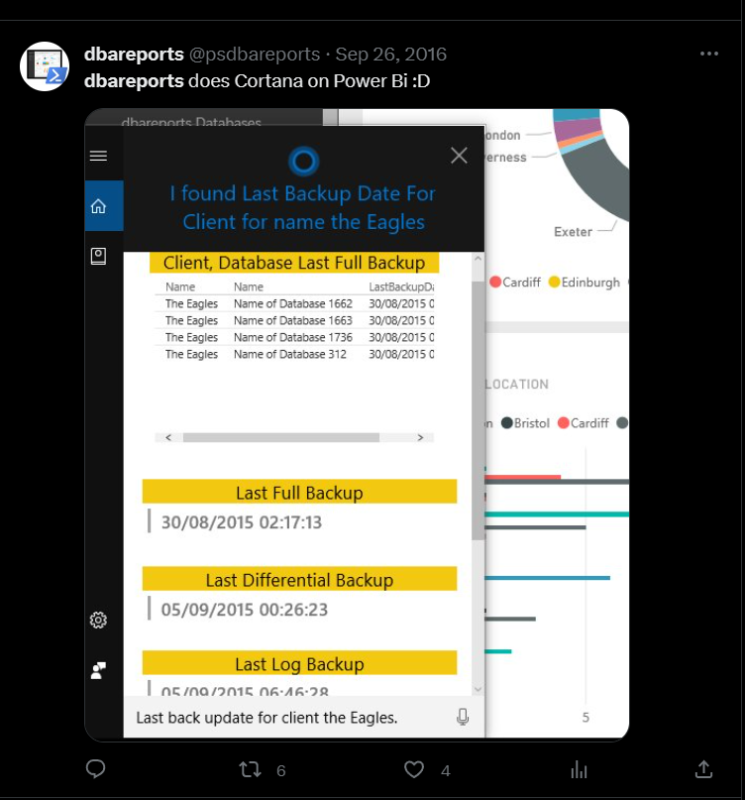
Evolution of dbachecks
2016
Initially, Rob created dbareports to validate and report on SQL estates
IT WAS SUPER COOL !!

Slide 10
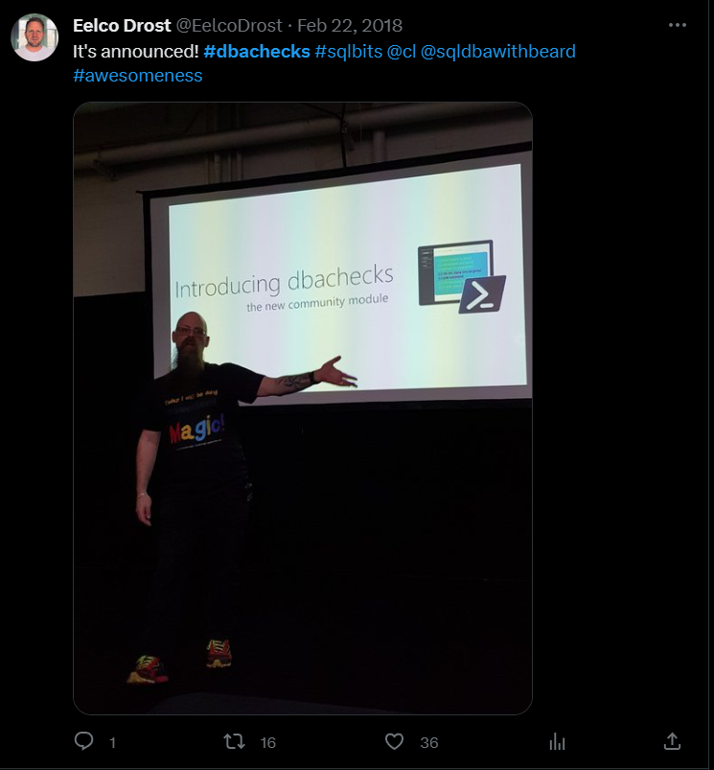



Evolution of dbachecks
2016
2022
Initially, Rob created dbareports to validate and report on SQL estates
dbachecks v3 redesigned framework and modularized checks.
2018
2020
dbachecks v1 released at SQLBits enabling configurable Pester checks using dbatools
dbachecks v2 added more validation checks and improved documentation.

Slide 11
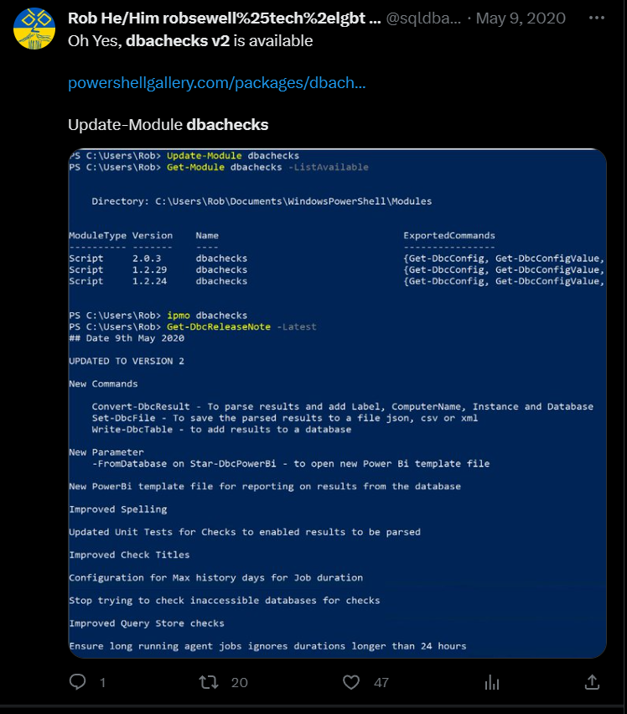

Evolution of dbachecks
2016
2020
Initially, Rob created dbareports to validate and report on SQL estates
dbachecks v2 released enabling conversion of results into PowerShell Objects and database loading
2018
dbachecks v1 released at SQLBits enabling configurable Pester checks using dbatools

Slide 12

Evolution of dbachecks
2016
2020
Initially, Rob created dbareports to validate and report on SQL estates
dbachecks v2 released enabling conversion of results into PowerShell Objects and database loading
2018
2023
dbachecks v1 released at SQLBits enabling configurable Pester checks using dbatools
dbachecks v3 released. Performance improvements and Pester v5

Slide 13
Some of our top dbachecks
Instance Connectivity
Check if the instance is connectable, pingable and using the expected authentication method.
Backup Status
Check if backups are being performed and respecting the configured policy.
Database Ownership
Validate that database is owned by the expected login.
Corruption Detection
Ensure all your databases have had a recent CheckDB to avoid corruption issues.
Certificate Expiration
Find certificates about to expire to avoid outages.
There are 140 checks so we couldn’t pick them all!
Notes:
Changed:
Title:
"Key Capabilities of dbachecks"
To
"Some Capabilities of dbachecks"
"Check that the tool can connect to database instances and gather information."
To
"Check if the instance is connectable, pingable and using the expected authentication method"
"Check any issues with database backups like failed jobs or inadequate backup settings.
To
"Check if backups are being performed and respecting the configured policy"
"Validate that databases are owned by the expected logins."
To
"Validate that database is owned by the expected login."

Slide 14
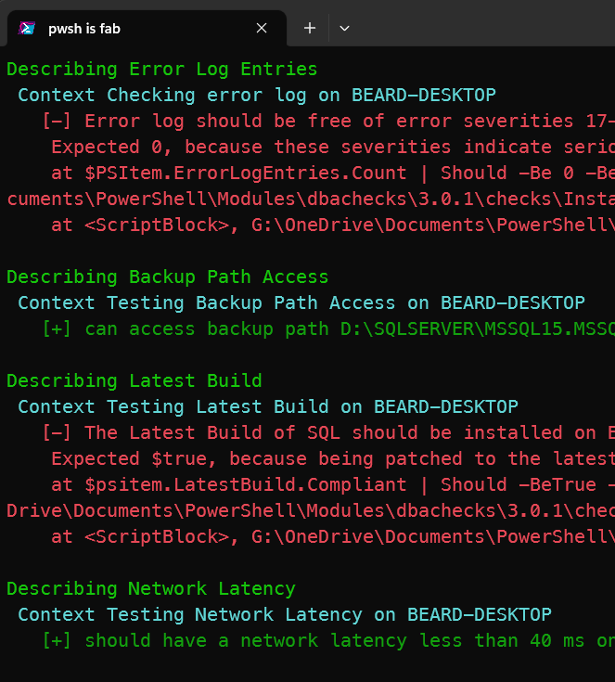
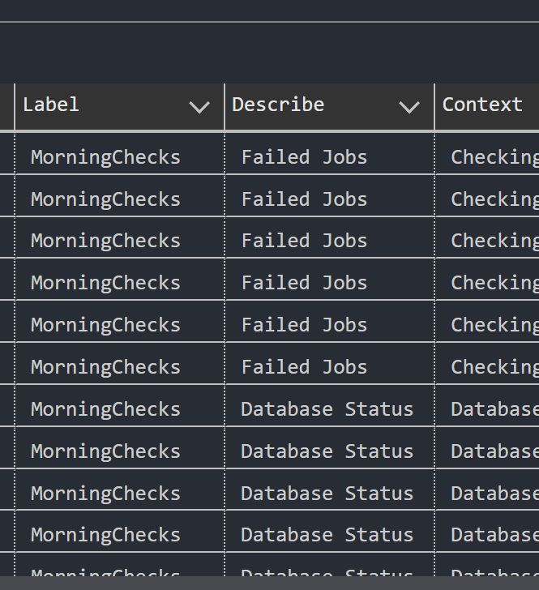

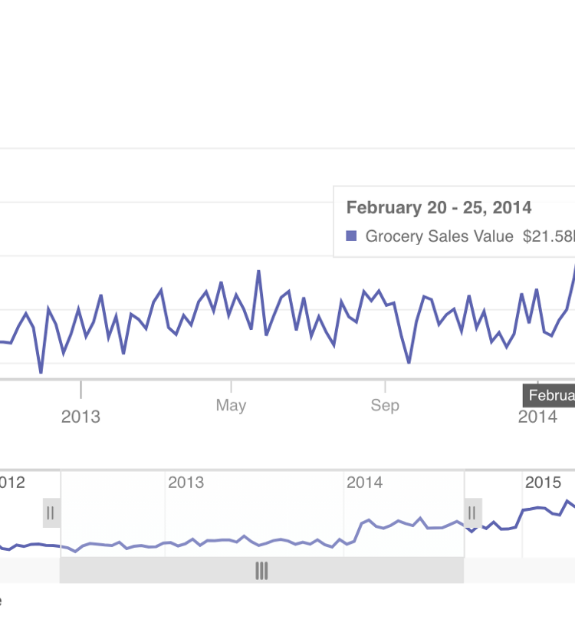
Viewing results
Results in the console
Results stored in SQL Server
PowerBI Report
Standard dbachecks output in the PowerShell console
Push those results straight into a SQL Server Database for safe keeping
Dashboard displaying dbachecks results, trends, and metrics.
Notes:
TODO – find some pictures and change this around?

Slide 15



Why Pester v5?
Faster test execution
Improved scalability for large test suites
Enhanced output formatting
Better compatibility for users
Notes:
Changed: Built-in support for testing DSC resources
To: Enhanced output formatting

Slide 16




Changes in dbachecks v3
Complete rewrite of dbachecks framework
Direct relationship with new and improved SMO
Standardized checks design
Backwards compatibility with Pester v4
The checks have been completely rewritten to create a framework for improved performance and scalability
New internal functions that optimize SMO calls to build the complete picture of an instance for just the checks you select.
Checks have been rewritten into a standard format. All checks can be skipped individually.
The legacy parameter enables checks to be run with older pester versions.
The complete rewrite of dbachecks using a modular framework positions it for controlled, predictable growth while maintaining compatibility with previous versions.
Notes:
Highlight that by default it will run in legacy mode to not break current processes & scripts

Slide 17
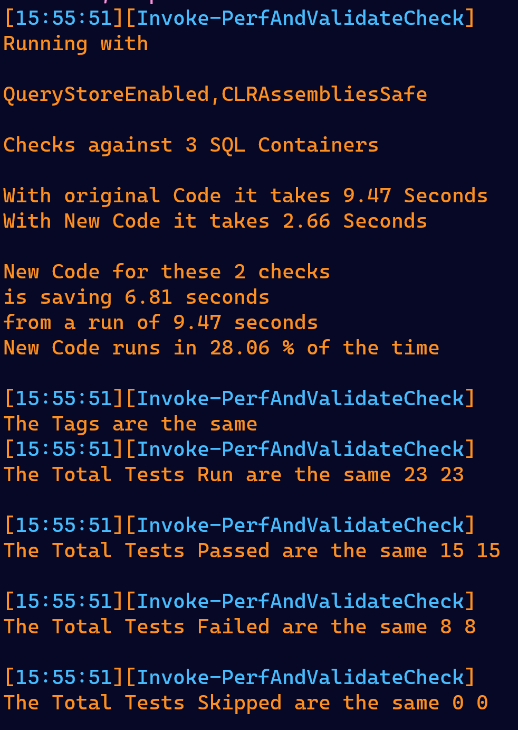
Testing every test
Are we getting the same results?
Is it faster?
Have we found bugs?
Notes:
Should I redo this screenshot with a light theme to make reading easier?
CS: Yes please.

Slide 18
New Features in dbachecks v3
Native PowerShell Module
SQL Server 2022 Support
Expanded Platform Coverage
dbachecks v3 ships with a native PowerShell module for easy installation and usage.
Full support for SQL Server 2022 including new features like SQL Server on Azure VMs and SQL on Kubernetes.
Covers a wider range of platforms including Linux, containers, Azure SQL Managed Instance, and Azure Synapse Analytics.
New and Updated Checks
Faster Performance
Enhanced Output
Over 50 new checks added and 120+ checks updated to cover latest best practices.
Significant performance improvements with up to 40% faster execution.
More detailed and customizable output in text, JSON, Excel and HTML formats.
Notes:
TODO – this one needs some changing – prob easiest to chat through this one ☺

Slide 19
Performance Increase
Performance improvement from dbachecks v2 to v3 measured in milliseconds to complete benchmark task
350
210
125
80
60
Task 1
Task 2
Task 3
Task 4
Task 5
Notes:
Do we need this slide? Since we have 17 showing improved performance?
CS: I vote removing it

Slide 20



Live Demo
Welcome
Overview
Scenario 1
Scenario 2
Scenario 3
Greet the audience and introduce the purpose of the live demo.
Provide a quick recap of dbachecks features and improvements in v3.
Demonstrate how dbachecks v3 identifies and fixes common configuration issues.
Show how easy it is to install and configure dbachecks v3.
Highlight the improved performance and scalability in dbachecks v3.
Invite questions from the audience and address them.
Notes:
Hidding this slide

